Slide 1
Book of Daniel Class 12 – Chapter 11 Winter 2023
Daniel’s last vision – Who was this vision written for? Daniel, the remnant, Medes, other Israelite leaders, us?
What language are we back to? Is that a hint?

Slide 2
Daniel – Rough Outline
Style
Ch 1-6: Story
Ch 7-13: Vision
2. The King’s Dream
7. Daniel’s Dream
3. The Fiery Furnace
6. The Lion’s Den
4. Nebuchadnezzar’s Pride
5. Belshazzar’s Pride
8. Daniel’s 2nd Vision
1. Recruited to Serve in Babylon
9. Daniel’s Prayer
10-12 Daniel’s 3rd Vision
HEBREW
ARAMAIC
HEBREW

Slide 3
The Book of Daniel (Structure)
Style:
Ch. 1-6: Story
Ch. 7-12: Vision
Ch. 1 Hebrew
Ch. 2-7
Aramaic
Ch. 8-12
Hebrew
Language:
Prologue
God rules in the kingdoms of man.
God preserves His sacred people.
Theme:
We are in this section now

Slide 4
Reminder…
Daniel
Ch 7
Ch 8
Ch 9, 11, 12
Ch 10
Ch 1
Ch 2
Ch 3
Ch 4
Ch 5
Ch 6
Captive! – Daniel 15 yo
Fiery Furnace – Daniel 22 yo
Neb. Dream – Daniel 30 yo
Statue Dream – Daniel 20 yo
Belshazzar writing – Daniel 80 yo
Darius Lions! – Daniel 85 yo
Cyrus the Mede – Daniel 90 yo
Belshazzar takes over – Daniel 40 yo
Belshazzar and Nabonidis rules

Slide 5
Daniel 10 – The Final Vision
Words of great conflict, Daniel mourns (1-3)
A terrifying angelic messenger (4-9,15-17)
Response to Daniel’s prayer (10-12)
Vision about God’s people (14)
”Latter days”, “days yet to come” (14)
Unseen spiritual warfare (13,18-21)
Something to do with Persia, Greece (20)

Slide 6
The Book of Daniel
Let’s read Chapter 11…

Slide 7
What is going on in Daniel 11?
Confusing and unfamiliar…
Yet the most detailed predictive prophecy in the Old Testament.
Overviews the next 400 years of Jewish history (539 – 167 BC) …
So accurately that many skeptics claim this was written after the fact (say 160s BC).
Manuscripts of the Book of Daniel found among the Dead Sea Scrolls (dated 120 B.C.) point to the book being written much earlier.

Slide 8
Daniel 11 - Overview
11:2-4 – Rest of Persian Empire to the rise/fall of Alexander the Great
From 539 BC to 323 BC
4th Persian king is Xerxes (Ahasuerus) from Esther
11:5-20 – Regional Greek history from death of Alexander to Antiochus IV (c.175 BC)
King of the North = Seleucid ruler (Syria)
King of the South = Ptolemy ruler (Egypt)
11:21-35 – Reign of Antiochus IV
”Little horn” of Daniel ch.8
Main focus of these final visions

Slide 9
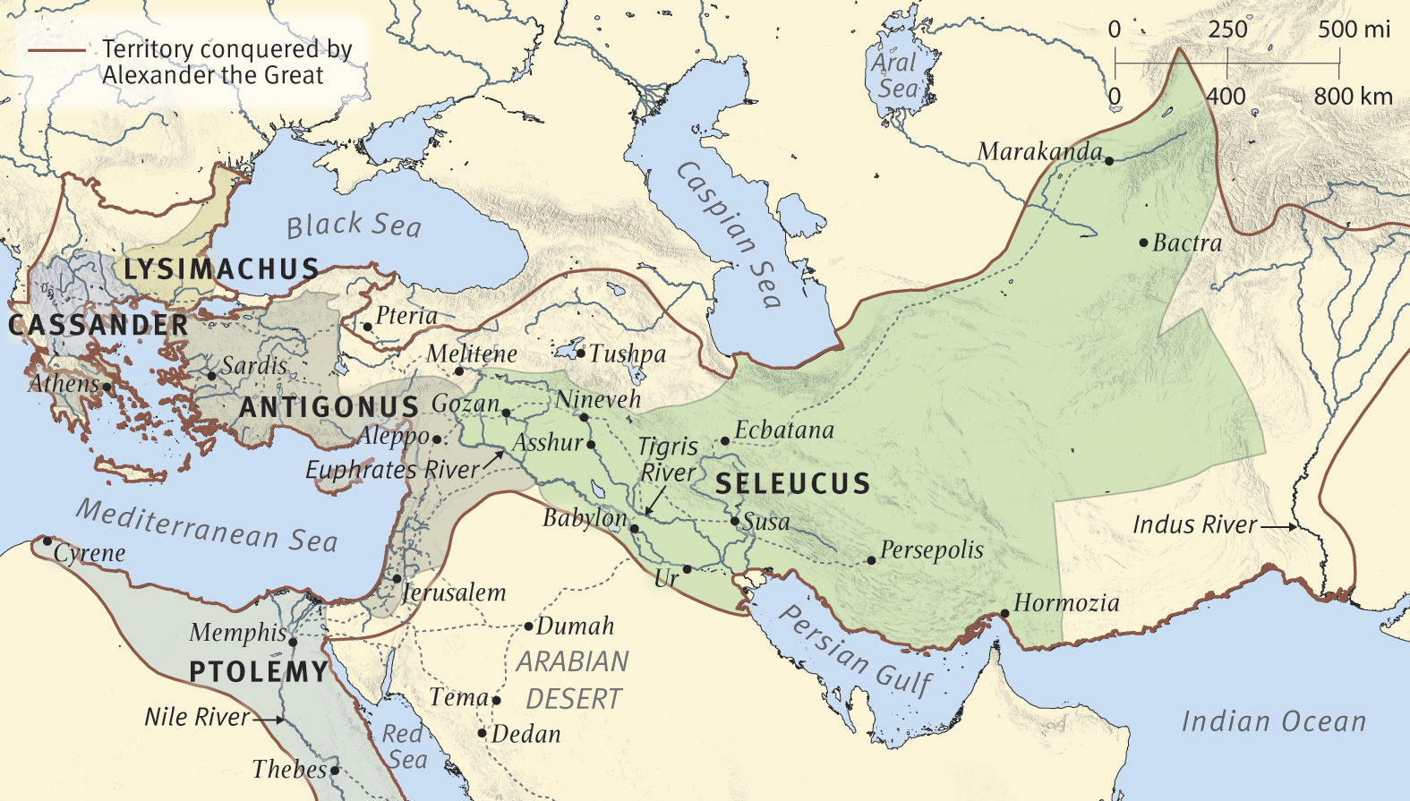
Greek World After Alexander
Then the king of the South will grow strong, along with one of his princes who will gain ascendancy over him and obtain dominion; his domain will be a great dominion indeed. After some years they will form an alliance, and the daughter of the king of the South will come to the king of the North to carry out a peaceful arrangement. But she will not retain her position of power, nor will he remain with his power, but she will be given up, along with those who brought her in and the one who sired her as well as he who supported her in those times. (11:5-6)
King(s) of the North
Ptolemy II (South/Egypt) gives his daughter Bernice to marry Antiochus II (North/Syria) in 252 BC. Antiochus’ ex-wife Laodice plots to murder Bernice & Antochius. Her father (Ptolemy II) dies the same year (246 BC).
King(s) of the South

Slide 10
Daniel 11:21-35 – Antiochus IV
11:21 – “a contemptible person”
Antiochus Epiphanes (“God manifested”)
11:22 – Breaks “the prince of the covenant”
High Priest Onias III replaced by his brother Jason, who bribed Antiochus for the position
11:21-23 – Antiochus rises to power
11:24-27 – First campaign against Egypt
11:28 – “Heart against the holy covenant”
11:29-30 – Turned back from Egypt (by Romans), takes out anger on the Jewish people
11:31-33 – Horrible persecution of the Jews, forcing many to give in to Hellenization.
11:34-35 – (limited) time of refining & purification

Slide 11
What about Daniel 11:36-45?
Failed prophecy? Claim of the unbeliever
End of human history? Why/how is there a giant gap from v.35 to v.36.
Roman destruction of Jerusalem? Perhaps, but again, large gap from v.35-36.
Still about Antiochus IV? Possibly, but only as a summary, not further history.

Slide 12
What to make of Daniel 11
What do you think we learn from all of this?
God’s foreknowledge is a comfort to us
We will not all be saved from the furnace
Will we resist the pressure and be faithful?

Slide 13
The Book of Daniel
Homework: Chapter 12…

Slide 14
Daniel: Class Schedule
# | Date | Class | Teacher
1 | Sun 12/3 | Class Introduction & Background | Robert McDonald
2 | Sun. 12/10 | Chapter 1 | Robert McDonald
3 | Sun. 12/17 | Chapter 2 | H.E. Jenkins
4 | Sun. 12/24 | Chapter 3 | Robert McDonald
5 | Sun. 12/31 | Chapter 4 | H.E. Jenkins
6 | Sun. 1/7 | Chapter 5 | H.E. Jenkins
7 | Sun. 1/14 | Chapter 6 | Robert McDonald
8 | Sun. 1/21 | Chapter 7 | H.E. Jenkins
9 | Sun 1/28 | Chapter 8 | H.E. Jenkins
10 | Sun. 2/4 | Chapter 9 | Robert McDonald
11 | Sun. 2/11 | Chapter 10 | Robert McDonald
12 | Sun. 2/18 | Chapter 11 | H.E. Jenkins
13 | Sun. 2/25 | Chapter 12 & Summary / Themes | H.E. Jenkins

